Slide 1

Adoption of ISA-95 as the foundation for an Automation Architecture
Eric C. Cosman
Automation Architect
The Dow Chemical Company

Slide 2
Abstract
Consistent and effective application of process automation in a large enterprise requires a well defined functional and technical architecture. A functional or system architecture that is based on established standards makes it easier to identify opportunities and to compare functions across suppliers and organizational boundaries. This presentation describes an approach to architecture development that involves collaboration with strategic suppliers to:
    1) provide better quality and more complete solutions,
    2) increase the use of standards, and
    3) contribute to the enhancement of standards.

Slide 3
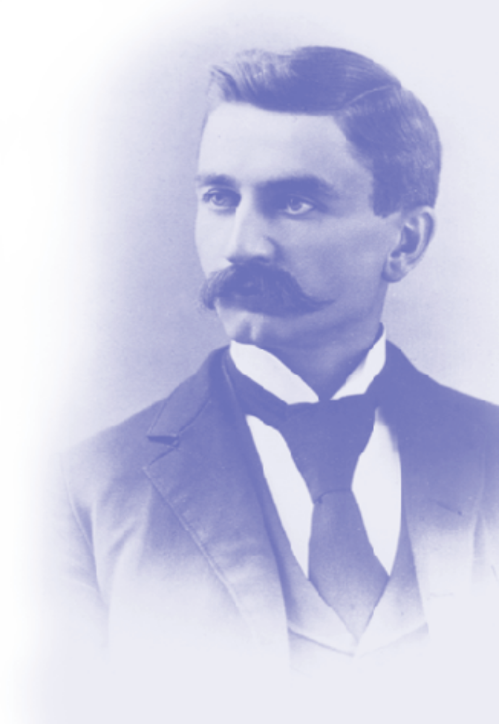
The Dow Chemical Company
Founded in 1897 by Herbert H. Dow in Midland, Michigan
Global science and technology company with annual sales of approximately $30 billion
Serves customers in more than 170 countries and a wide range of markets that are vital to human progress
Mission - “To constantly improve what is essential to human progress by mastering science and technology.”
Notes:
Most of you are probably familiar with my company. The Dow Chemical Company has been in business for over a hundred years, beginning and still headquartered in Midland, Michigan.
This slide borrows just a few of the major points that describe who we are. Much more detailed information is available on our web site (http://www.dow.com)

Slide 4
Dow Process Automation
Sub-function within the Manufacturing & Engineering function
Over 400 people deployed globally
Operates as an internal business
Delivers reliable, cost-effective, value-added automation solutions to Dow Businesses
Scope of ‘Automation’ generally consistent with industry standards
Notes:
Within Dow we have an organization called “Dow Process Information”, which is part of our larger Manufacturing and Engineering function. We have over 450 people spread across various locations around the world. We operate as an internal business, providing services in selection, design, configuration, support, and consulting for our various business units.
In naming our our organization we deliberately chose the term “process automation” rather than “process control” in order to emphasize the breadth of our offerings. We are responsible not only for the traditional basic process control and safety systems, but also the various information management systems that are connected to them.
If you are familiar with the terms of the ISA S-95 model, our scope is equivalent to what is described as “Manufacturing Operations and Control”, spanning from the instrument to the Enterprise level systems.

Slide 5
Related Patents
The Dow Chemical Company holds the following U.S. patents on the subject of integration of Manufacturing and Business information systems:
6,345,259 (System and method for integrating business and manufacturing environments)
5,463,555 (System and method for integrating a business environment with a process control environment)
6,141,647 (System and method for integrating a business environment, a process control environment, and a laboratory environment)

Slide 6
Agenda
What has been
What is
  Current activities and challenges
What may (will) be
  What can we accomplish?
Automation philosophy
Strategic intent
Principles
Architecture in Dow
Notes:
Let me begin by saying that I am probably not going to say anything that you have not heard or read before. We are all well aware of the basics of the challenges facing us in process systems security. Some of you are probably better qualified than I am to talk about this topic.
My goal is to give you a perspective on the subject; what we at Dow are thinking and how we make some of our decisions.
In order to understand what we are really dealing with here, we first have to understand the nature of the challenge, both from a historical perspective as well as in terms of how it may be changing even as we speak. The fundamental challenge has remained unchanged almost from the beginning, but it is useful to go back and think about it a bit in order to understand the full implications.
The traditional or historical response to this challenge is also important to review, simply because we have to understand why it is no longer appropriate or sufficient.
What is needed is a broader or more comprehensive approach to the problem than has traditionally been the case. We’ll spend some time talking about what that means.
Even with the broader response proposed, challenges remain. There are several lessons that we have learned in expanding this response, and it is worthwhile to review those also.
Finally, I’ll close with a quick summary of some of the areas where I believe there is still much to be done.

Slide 7

Automation Philosophy
Process Automation is an integral part of process engineering.
Standardize processes and practice across the company - it saves time, eliminates errors and simplifies everything
Go outside to get the best thinking on basic standards and solutions
Save valuable internal resources to focus
on optimizing these basic solutions across
specific businesses and processes

Slide 8
Strategic Intent
Design and implement lowest life-cycle cost automation solutions that maximize asset utilization and productivity with no unplanned process events.
Commercial products have the potential for significant productivity gains:
  Faster project implementation by using standardized object-oriented engineering
  Faster leveraging of technology with reusable objects
  Commercial platforms lower system development and support costs to Dow

Slide 9
Key Principles
Combine supplier and industry directions with current assessment (installed base) to provide the basis of a series of contracts with Businesses on paths to new standard systems.
Based on a balance of strategic relationships with chosen suppliers
  recognizing that their visions are not totally complementary
  Consistency with evolving industry standards

Slide 10
Key Principles
Life Cycle-based planning and decisions:
  Investment and project decisions will be based on a full economic life cycle analysis
  Product and technology directions described in terms of the Technology lifecycle model
Use industry models as high level blueprints:
  ARC
  ISA
  IEC

Slide 11
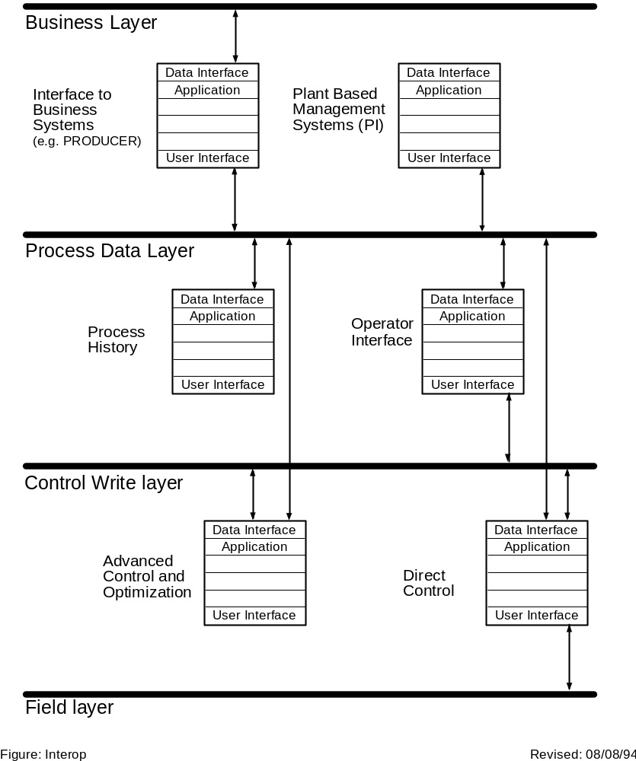
Architecture in Dow c. 1994
ISA-95
Enterprise Information
Plant Production Scheduling,
Operational Management, etc
Product
Definition
Information
Production
Capability
Information
Production
Information
Manufacturing
Control Information
Area Supervision, Production, Scheduling,
Reliability, Assurance, etc

Slide 12
Agenda
What has been
What is
What may (will) be
Objectives
Current activities
Challenges
Notes:
Let me begin by saying that I am probably not going to say anything that you have not heard or read before. We are all well aware of the basics of the challenges facing us in process systems security. Some of you are probably better qualified than I am to talk about this topic.
My goal is to give you a perspective on the subject; what we at Dow are thinking and how we make some of our decisions.
In order to understand what we are really dealing with here, we first have to understand the nature of the challenge, both from a historical perspective as well as in terms of how it may be changing even as we speak. The fundamental challenge has remained unchanged almost from the beginning, but it is useful to go back and think about it a bit in order to understand the full implications.
The traditional or historical response to this challenge is also important to review, simply because we have to understand why it is no longer appropriate or sufficient.
What is needed is a broader or more comprehensive approach to the problem than has traditionally been the case. We’ll spend some time talking about what that means.
Even with the broader response proposed, challenges remain. There are several lessons that we have learned in expanding this response, and it is worthwhile to review those also.
Finally, I’ll close with a quick summary of some of the areas where I believe there is still much to be done.

Slide 13
Objectives
Minimize Hype - Maximize Value
Align technology introduction with business drivers (not vendor’s product cycles)
  Align all technologies and their inter-dependency to drive better business decisions subject to the I/T Investment timing
Select optimum time to adopt new technology
  High Value - Early Adoption
  Low Cost - Late Adoption
Position industry trends with a Dow perspective
Identify opportunities / drivers to eliminate obsolete technology
Provide a change scenario to senior management as a basis for investment decisions.

Slide 14
Automation Architecture
Provides the foundation (principles, models & standards) for delivering solutions.
Evolved from over 20 years of experience, validated against industry models and standards.
Aligned with company IT architecture and IT industry standards.
Maintained by the Automation Technology Center.

Slide 15
Building on a Solid Foundation
Operational Excellence
(Asset Utilization, etc.)
Best Automation Solutions
Advanced, Regulatory & Safety Control
Information Access & Presentation
Connectivity Through Standard Networks
Integrated Engineering Data
Defined Migration
Paths
State-Based Control
Capture, Leverage & Automate Best Practices
Business System Integration
Work Process Integration
Object Technology
Products & Technology from
Strategic Suppliers
Industry Trends, Directions
and Standards
Dow Values, Knowledge and Experience in Automation
Notes:
The purpose of this slide is to show how we are “building” towards our vision of operational excellence, based on a solid foundation. The bedrock of this foundation is Dow’s long history, experience and proven track record in delivering value to businesses through the use of strategic use of automation to drive a higher level of operational performance. We must maintain this as we move forward with future systems.
We add to this through a combination of established and emerging industry standards, and a carefully tailored selection of products and technologies from our preferred suppliers.
The combination of these two foundation layers provides us the base upon which we can deliver the various attributes should in the vertical bars.
All of these in turn contribute to (support) our vision of “Best Automation Solutions”, which in turn make a significant contribution to the company goal of “Operational Excellence” (Flawless Execution, Amazed Customers)

Slide 16
Activities
Consolidation of Process Control & Monitoring
  Extend principles and practices to new platforms
  Address operational challenges arising from use of COTS technologies (e.g., security)
Building strong relationship with a limited set of key suppliers
Working partnership with I/T for Production Management
Focus on providing “Most Effective Technology”

Slide 17
Challenges
Diversity in current installed base
  remediation, coexistence, migration or replacement?
Establishing effective partnerships
  internal and external
  “Relationship management”
Evolution of standards
  “broad enough to embrace; specific enough to implement”
  accelerate the process

Slide 18
Agenda
What has been
What is
What will (may?) be
Integration
Operational Excellence
Convergence
Barriers
Notes:
Let me begin by saying that I am probably not going to say anything that you have not heard or read before. We are all well aware of the basics of the challenges facing us in process systems security. Some of you are probably better qualified than I am to talk about this topic.
My goal is to give you a perspective on the subject; what we at Dow are thinking and how we make some of our decisions.
In order to understand what we are really dealing with here, we first have to understand the nature of the challenge, both from a historical perspective as well as in terms of how it may be changing even as we speak. The fundamental challenge has remained unchanged almost from the beginning, but it is useful to go back and think about it a bit in order to understand the full implications.
The traditional or historical response to this challenge is also important to review, simply because we have to understand why it is no longer appropriate or sufficient.
What is needed is a broader or more comprehensive approach to the problem than has traditionally been the case. We’ll spend some time talking about what that means.
Even with the broader response proposed, challenges remain. There are several lessons that we have learned in expanding this response, and it is worthwhile to review those also.
Finally, I’ll close with a quick summary of some of the areas where I believe there is still much to be done.

Slide 19
Domains of Integration
Non-Strategic
Indirect
Build My
Plant
MRO
& Supplies
Surplus
Equipment
Procurement
Services
eMarket
Freight
Eagls
HR
EPC’s
External Enterprise Integration Layer
Document &
Business
Process
Oriented
Internal Enterprise Integration Layer
Service Oriented Architecture
Transaction Oriented Architecture
Enterprise Core Applications
ERP
CRM
SCM
Bus Reporting
Request
Request
Reply
Reply
Fire Wall
Fire Wall
Configured
by Site or Plant
Transaction
Oriented
Configured
by work
process
Domain Integration
Data
Domain Integration
Configured
by Business or
Plant
Domain Integration
Execute
Execute
Execute
Process Control
Maintain
Domain Integration
Application
Application
Application
Application
Execute
Configured
by Plant
XML
Data Focused
XML
Build
Data Focused
Application
Application
Data Focused
XML
Application
Application
MES
XML

Slide 20


Operational Excellence
Balanced Scorecard
Targets
Production Management
Operator Training & 6Sigma
Performance Management (Latent)
Work Process Mgmt Facility
Manufacturing Strategy Benchmarking
Abnormal Condition
Performance Business - Plant - Process
Quality LIMS
Maintenance
History
Continuous Improvement Benchmarking - Best Practices
Process Control & Monitoring
Progress & Performance Visualization
Trouble Shooting & Correction
Production Supervision (Real-Time)
Explicit Control & Transitioning
Performance Monitoring
Procedural Best Practices
Operational Perspective
Event Monitoring

Slide 21
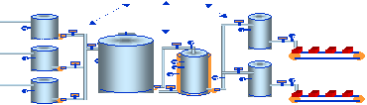
Convergence
Business Planning & Supply Chain Mgmt
Business Process transactions
Business Work Processes
Production Definition
Production Capability
Production Plan
Production Information
Process Automation
Manufacturing Work
Processes
Production Management transactions
Production Management
Real-Time Control & Events
Continuous
Batch
Logic
Sensors, Actuators & Logical Devices

Slide 22
Thank you
Eric C. Cosman
Automation Architect
The Dow Chemical Company
eccosman@dow.com

